Slide 1
Sustainable Transportation Development – A Trinidad and Tobago Perspective
Presented by
Dr. Trevor Townsend
Organization of American States
Sustainable Cities Course 2nd Edition

Slide 2
Quick Description of T’dad & T’bgo
Twin Island State
Pop 1.3 Mn.
Former British Colony (1962) now Republic (1976)
Oil/Natural Gas Based Economy (40% GDP, 80% Exports , 5% Employment)
GDP per capita USD$18,400 (2013)

Slide 3
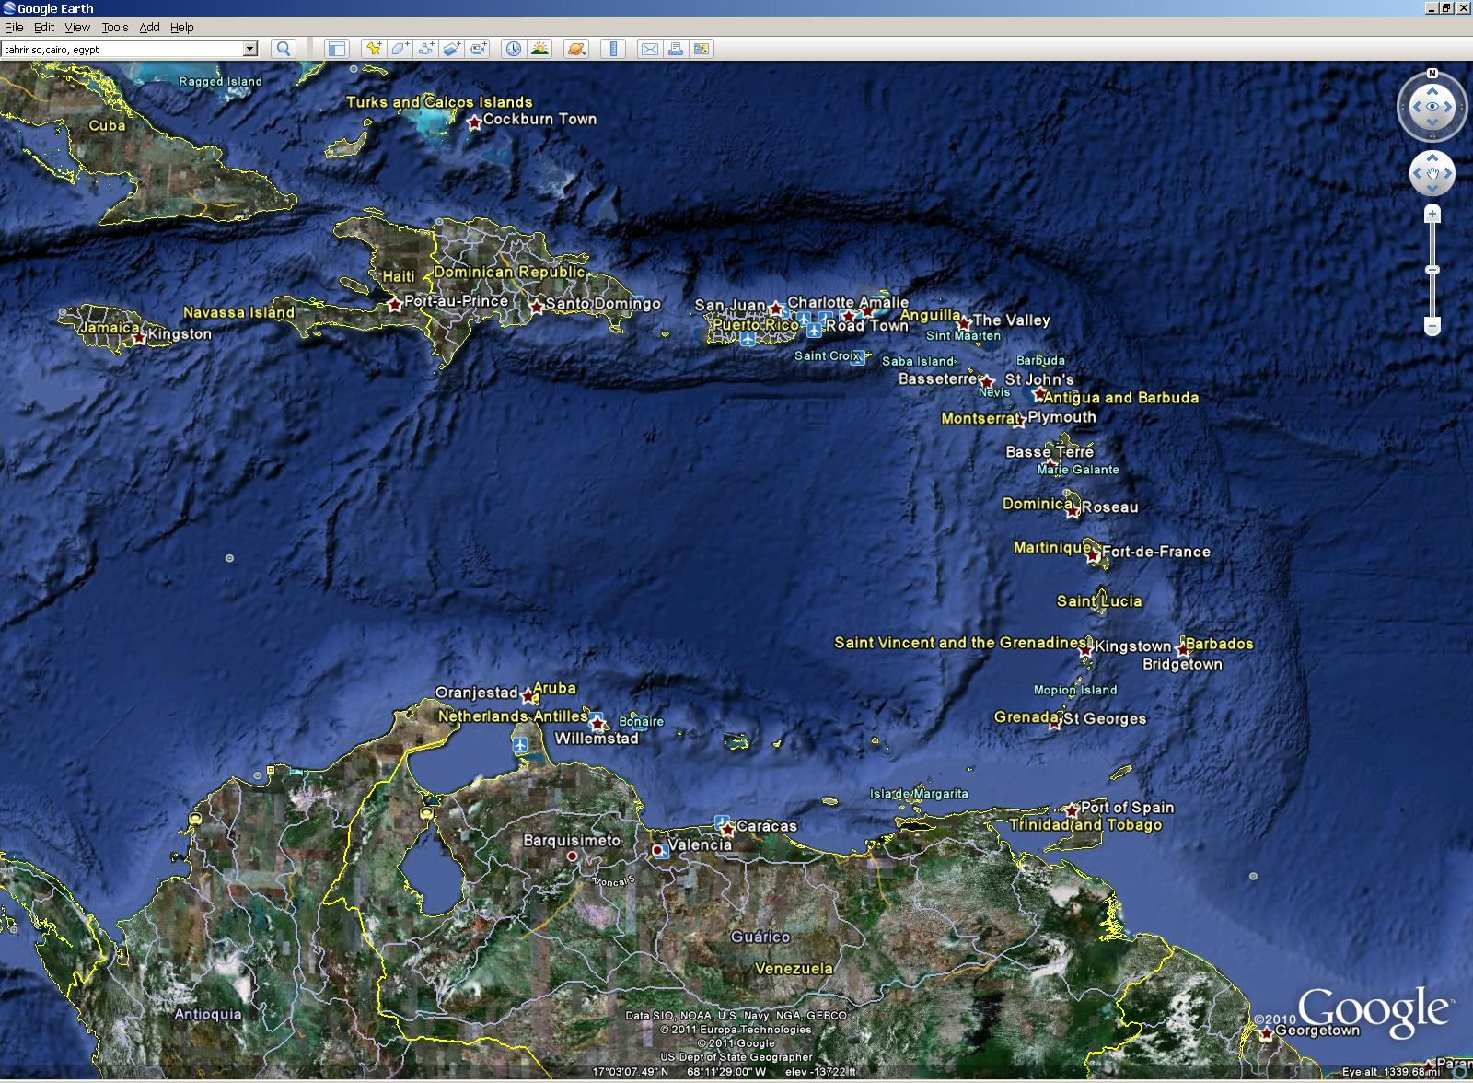
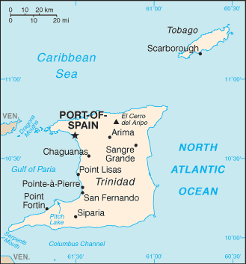

Slide 4
Trinidad & Tobago Cont’d

Slide 5
Trinidad & Tobago Cont’d
Unemployment rate - 3.5%
Median Age - 32.6yr
Urbanization – 13%
Pop under 14 yrs - 20%

Slide 6
Transportation System Characteritics
Well Developed Highway System linking E-W and N-S communities
High Per Capita Auto Ownership - 2.5
90% of public transportation by 25,000 privately –owned 4-5 passenger sedans and 4,500 privately-owned 9-25 seater para-transit vehicles.
Informal taxis operate on rural routes and unsociable hours.

Slide 7
Major Highway Interchange

Slide 8
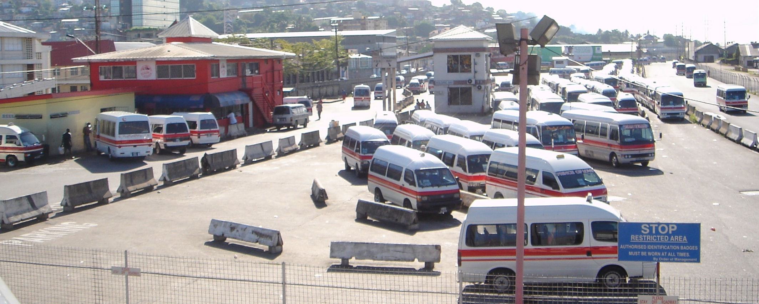

Slide 9
Transportation System Characteritics Cont’d
State Owned bus company , PTSC, operating 300 medium, full-sized and articulated buses per day.
Both Bus and taxi services operate without published schedules.
Priority Bus Route (PBR) from Arima to Port of Spain
Heavily Subsidized low-volume luxury Water Taxi System linking North to South.

Slide 10
Transportation System Characteristics Cont’d
Ferry Service from POS to Scarborough
Two Major ports handling international and regional cargo.
Two International airports
State owned International Air carrier Caribbean Airlines recently merged with Air Jamaica

Slide 11
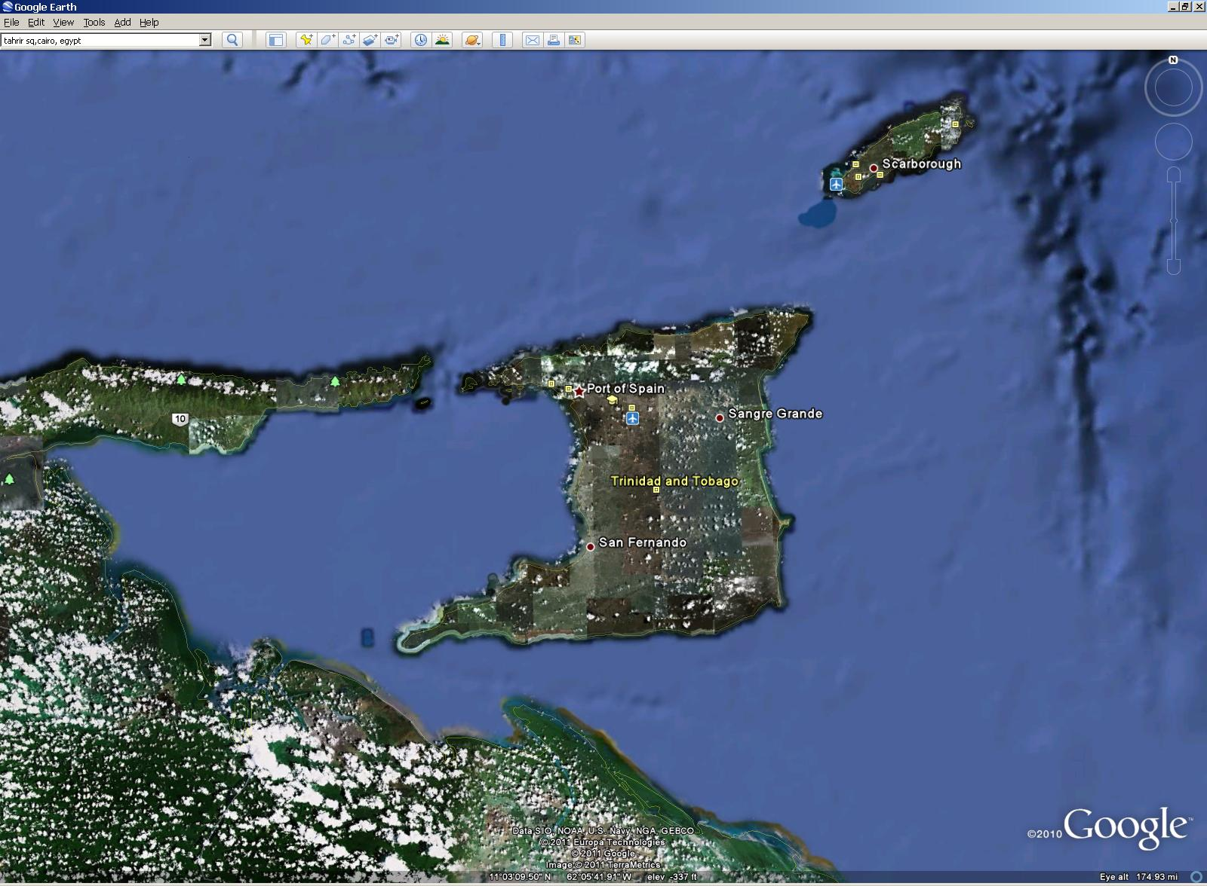

Slide 12
“Sustainable Development is development that meets the needs of the present without compromising the ability of future generations to meet their own needs”
Source: 1987 World Commission on Environment and Development – report to the United Nations

Slide 13
Key Transportation/Land Use Requirements for Sustainability
Integrated Land Use/Transportation Planning
No National Physical Development Plan since 1984
National Spatial Development Strategy being drafted
No approved National Transportation Policy since 1967.
Major Government Building Investments during 2002-2010 encouraged further centralisation of employment opportunities and activities

Slide 14
2. Develop Clean,Safe, Efficient, Affordable Public Transportation Options
Without doing a pre-feasibility analysis, GOTT spent USD$100Mn. for design of 120km. Passenger Rail system est. Capital cost USD$3Bn and est. annual cost USD$0.5Bn.
Each successive Government encourages further encroachment of private cars on the Priority Bus Route.
PTSC has had increases in fleet but lacks adequate maintenance facilities and mangement capability for existing fleet.

Slide 15
2. Develop Clean,Safe, Efficient, Affordable Public Transportation Options cont’d
Apparent “Tacit” Approval of unsafe, inefficient “PH” taxi and van services
Major Transportation Capital investments are all Automobile Oriented
Importation of Foreign Used Vehicles has accelerated

Slide 16
3. Ensure Access to Affordable Rural Transport Services
We have recommended the establishment of a National Transit Authority to determine and ensure delivery of minimum standards of transportation services to all communities.
PTSC put 99 buses on 66 new rural routes over the period 2007 - 2011.
Many Routes exist in name only

Slide 17
4. Address the mobility needs of special groups e.g. elderly and disabled
Eldamo para-transit services for the elderly and disabled was implemented. The project is to be extended to include more vehicles and routes.
There needs to be a focus on Universal Design of vehicles and facilities and the establishment of minimum standards

Slide 18
5. Facilitate walking & non-motorized transport in urban centers
There has been no planning or infrastructure development in this area.
The streets of major urban centers are not pedestrian friendly.
Bicycles , scooters and motorcycles are underrepresented as a transport mode.

Slide 19
6. Reduce Air Pollution & Carbon Emissions
GOTT has set up a high level Task Force mandated to implement measures required to maximize the use of Natural Gas in Trinidad and Tobago. The terms of reference include:
Updating the Petroleum (CNG) Regulations
Developing a Public education program for the green fuel

Slide 20
6. Reduce Air Pollution & Carbon Emissions cont’d
Moving from less than 1% to 15 – 20% of the vehicle population (i.e. about 75,000 to 100,000 vehicles) to CNG, especially the high mileage vehicles
A 40% reduction in liquid fuel volumes which in turn will significantly reduce the petroleum subsidy bill
A 10 – 15% reduction in the carbon footprint of the transportation sector.
Targeting up to 20 dedicated and 40 multi-fuel CNG filling locations, as well as 20 CNG conversion/repair centers

Slide 21
7. Improve the Logistics Performance Index
Estimated to be less than Jamaica (2.53; Rank 108th)
Management of Port Operations has improved over the last four years.
Expansion and Capital Investment Required.
Implementation of Asycuda World stalled and resisted.
Delays in Passing Border Control Legislation

Slide 22
8. Major Constraints to Progress
Lack of Desire
Higher Priority on Affordability than Sustainability
Short Term rather than Long Term Priorities

